Slide 1
What would a perfect world look like?
By Ivy Armitage

Slide 2
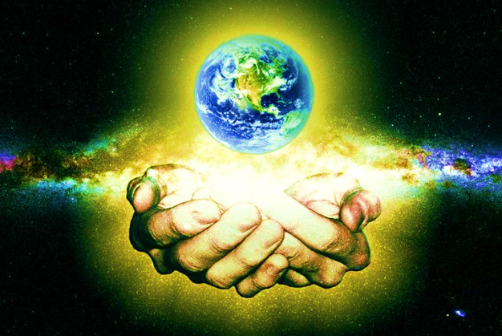
A perfect world is the one God created.

Slide 3
These are a few ideas I think we could do to make the world a better place..

Slide 4
Stop Deforestation!
Plant more trees to create homes for wildlife
This will help us to have cleaner air

Slide 5
Everybody has a home
People would have equal amounts of money, no rich, no poor.
Everyone could live and have food to eat

Slide 6
No fighting
People would be kind and fair

Slide 7
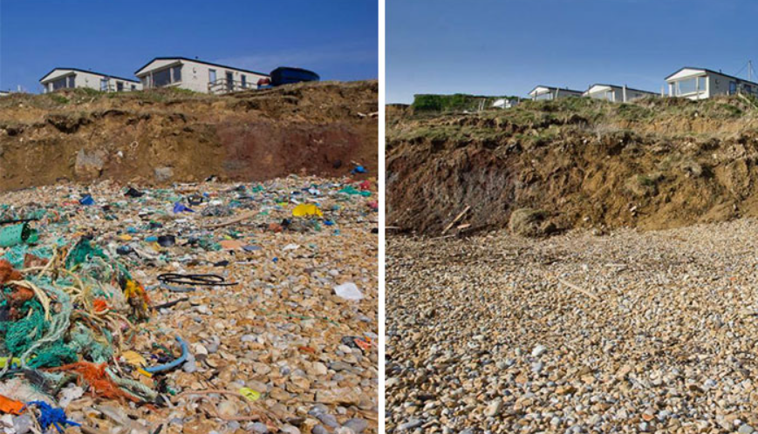
No pollution
Clean oceans to keep the animals safe
Our world would look more beautiful without litter

Slide 8
Everybody would be healthy
Healthy planet healthy people
Healthy Oceans + Rivers = Water
Healthy plants + animals = Food
Less illness and disease

Slide 9
Perfect!

