Slide 1
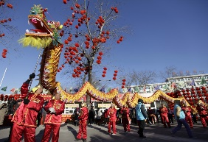
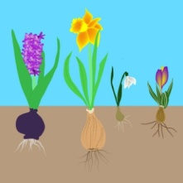
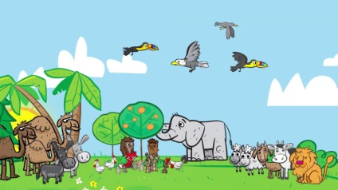
People & Communities
Chinese New Year- how is it celebrated.
Communication, Language & Literacy
Little Snowflake
Planting a Rainbow
Mary Mary Quite Contrary
The Enormous Turnip
The Run Away Pancake
Expressive Arts & Design
Mixing colours to make winter pictures
Joining materials together to make snowflake shapes
Chinese Dragons
Maths
Number 3 – Subitising, 1:1 Counting, Numerals, Triangles
Number 4 – 1:1 Counting, Numerals, Squares, Rectangles, Composition of 4
Number 5 - 1:1 Counting, Pentagon, Composition of 5
I wonder what is new?
Nursery Spring 1 2024
Physical Development
Sports Explores
Fast Freddie
The World
Taking care of the environment
From Bulb to Flower
RE
Looking after Gods creation
The Baby Birds – Muslim Story about the World in which we Live
The Tiny Ants – A Muslim story about the importance of caring for the natural world.
A wedding Wish for Puddles
PSED
Tick Box – Doodle Feels Calm
Safer Internet Day
Mental Heath Week

