Slide 1
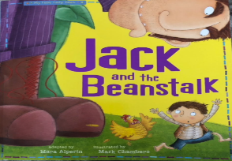
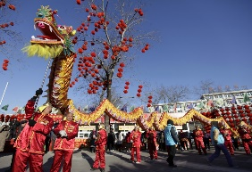
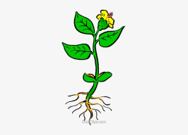
Communication, Language & Literacy
Little Snowflake
Jack and the Beanstalk
Jaspers Beanstalk
Little Red Hen
People & Communities
Different Occupations
Chinese New Year- how is it celebrated.
Expressive Arts & Design
Mixing colours to make winter pictures
Joining materials together to make snowflake shapes
Chinese Dragons
Painting Characters from stories
Maths
Numbers 3, 4, 5
Subitising
1-1 Counting
Numerals
Composition of numbers
2D Shapes
I wonder what is new?
Nursery Spring 1 2024
The World
Taking care of the environment
Life Cycle of a Bean
Seasons
PSED
Tick Box – Doodle Feels Calm
Safer Internet Day
Mental Heath Week
Physical Development
Sports Xplorers
Balancing Bella
Soccatots
RE
Looking after God’s World

